Slide 1
Design Selection Widget (ListView, Spinner, AutoComplete)
Fathan Maulana Rifqi Hartono
E41212174
Teknik Informatika Kampus Bondowoso Gol.B
Semester 4

Slide 2
Link Prototype Figma
https://www.figma.com/proto/e62LAPVuWEjsclep5Dem4Y/UI-%2F-UX-Design?node-id=429%3A23&scaling=scale-down&page-id=0%3A1&starting-point-node-id=429%3A23&show-proto-sidebar=1

Slide 3
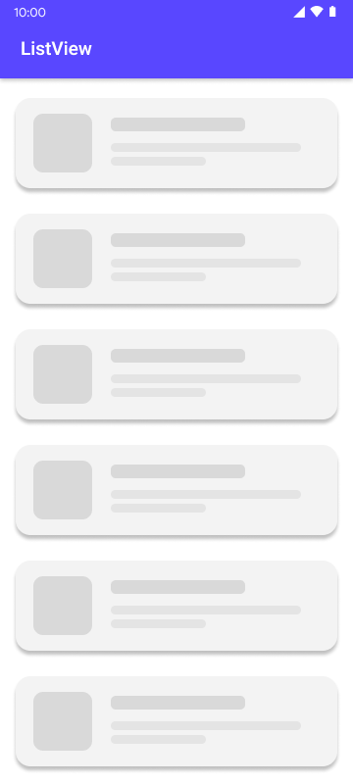
ListView

Slide 4
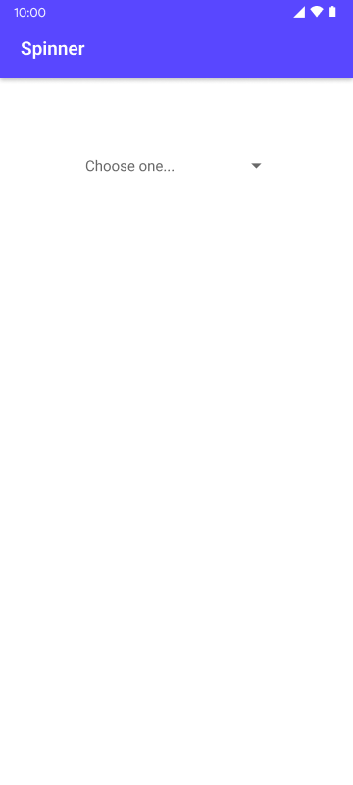
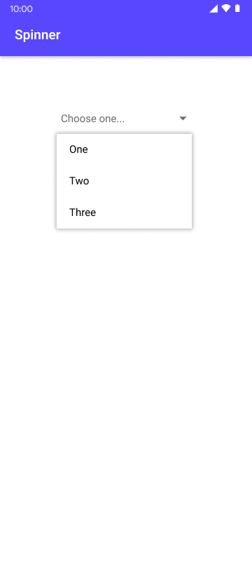
Spinner

Slide 5
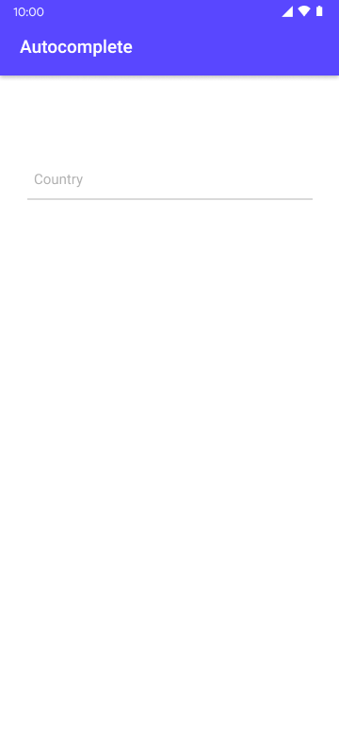
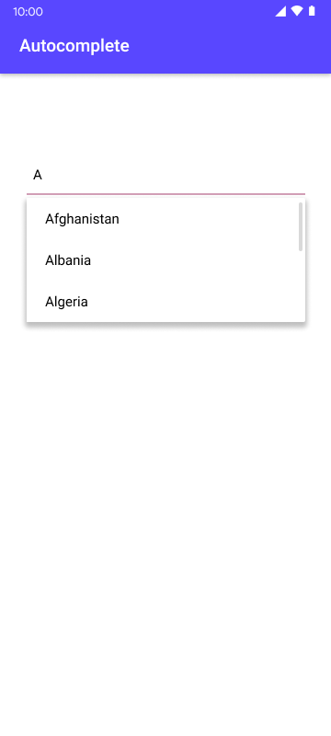
ListView

